Slide 1
Dusky Shrew (Sorex monticolus) Management Plan
Amy Hanson, Emma Hoogland, Maeranne Shenner

Slide 2
Overview
Dusky shrews are a staple in the diets of ermine on Haida Gwaii
Haida Gwaii ermine are listed as a species at risk under COSEWIC
There are lower populations of dusky shrew due to invasive rats
Eradicate rats
Increase shrew population
Increase ermine population

Slide 3
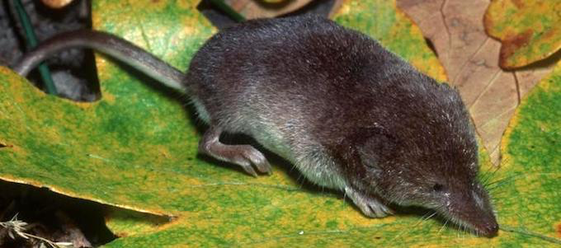
Dusky/Montane Shrew
Small mouse-like mammal
Widespread throughout Can/States
Difficult to identify
Prefer wet/acidic soil
Open fields/clearcuts near water source
Reproduce 3-4 times per season
2-9 young per litter
Live 12-18 Months
Active 24h/day, do not hibernate
Insectivores
Eats pests/ feeds important predators
Population unknown

Slide 4
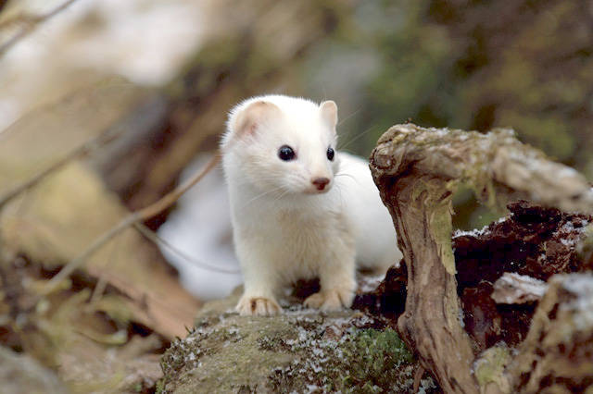
Ermine
Haida Gwaii Ermine Prey
  Ermine adaptations
  Keen’s mouse and Dusky Shrew
Predator-Prey Link
  Link between predator/prey densities
  Link between prey and food availability
Haida Gwaii Prey Disadvantages
  Limited prey
Overlap of Ermine and Marten Prey
  Competition
Introduced Species
  Possible predation

Slide 5
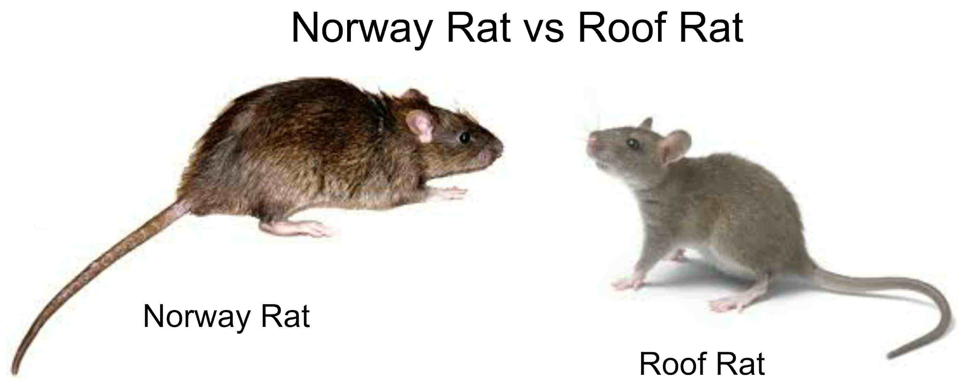
Invasive Rats
Norway rat (Rattus norvegicus) and Black rat or Roof Rat (Rattus rattus)
2 Threats:
  Outcompete shrews for food
  Direct predation on shrews
Eradications proven to be effective
  Can lead to non-target poisoning
  Shrew deterrent traps
  Flexible shrew populations
  Reintroductions
Research
  Better trapping/ baiting
  Population monitoring

Slide 6
Management Plan
Management Goal- To increase Dusky Shrew populations on Haida Gwaii by further eradications of rats and protection for critical habitat in order to provide a larger amount of prey for Ermine which are endangered on Haida Gwaii.
Objectives
Provide current population estimates of Dusky Shrew on Haida Gwaii through monitoring and research.
Identify critical habitat of Dusky Shrew and determine if protection of these areas is necessary.
Determine the extent of threat Norway Rat (Rattus norvegicus) and Black Rat (Rattus rattus) have to populations of Dusky Shrew.
Eradication of rats and further research on rat baiting that will not attract shrews.
Further monitoring of Dusky Shrew, rat, and ermine populations to determine impacts of rat eradication and establish new population estimates.

Slide 7
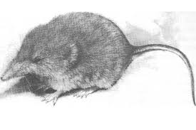
Conclusion
The dusky shrew is one of the many native species found on Haida Gwaii and plays an important role in the ecosystems
By eradicating invasive rats dusky shrew populations will rise
This population increase will benefit the Haida Gwaii Ermine that is endemic to Haida Gwaii and is currently a threatened species
Through the implementation of this management plan, we will work to get these goals achieved
Knowledge gaps to cover in order to successful implement the plan

